Slide 1

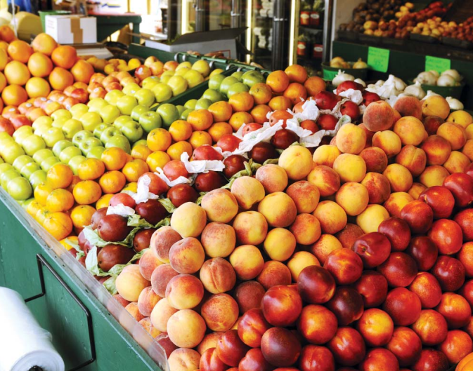

Slide 2
The Problem
Obesity and obesity-related diseases and health care costs are a growing problem.
Adult obesity rate in Philadelphia is 32.2%; among African Americans, it’s 38.4%.
Studies show limited access to healthy food and lack of exercise are contributing factors to the obesity crisis.

Slide 3
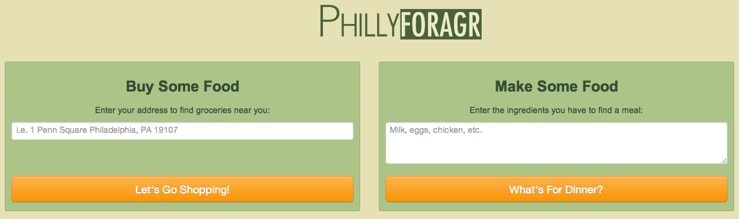
A Solution
Notes:
Update Screenshot

Slide 4

The Scenic Route
Notes:
Update Screenshot

Slide 5
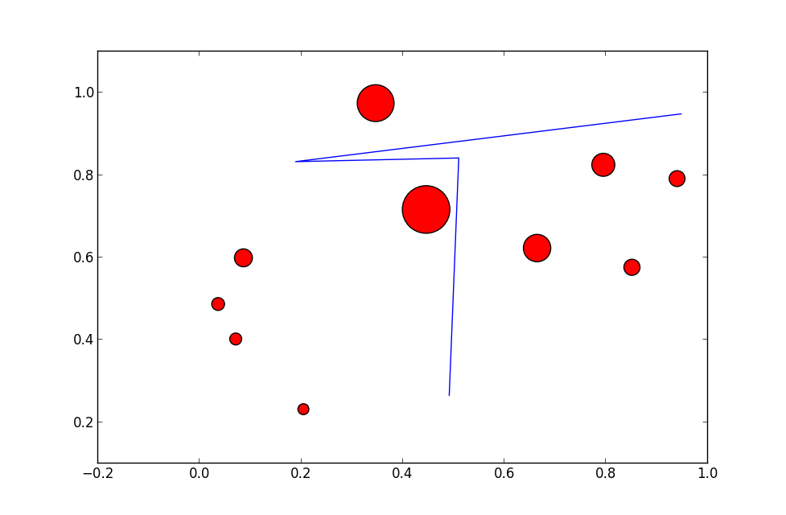
The Scenic Route
Notes:
Update Screenshot

Slide 6
Potential Improvements
Including healthy food retailers that do not accept SNAP
Provide an easy-to-navigate guide to SNAP benefits
Filtering out unhealthy foods by specific criteria (calories per serving, fat content, etc.)
Highlighting retailers that do not sell GMOs
An SMS interface utilizing Twilio
Notes:
Update Screenshot

Slide 7
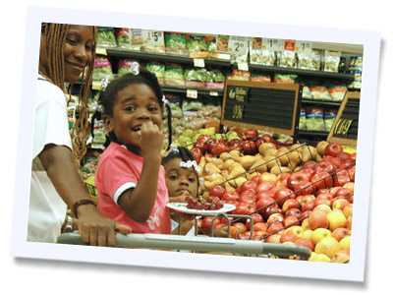
Follow us: @PhillyForagR
facebook.com/PhillyForagR

